Slide 1
Pattern Recognition in Natural Science
by Christos Mavrikis & Bram van deR Venne

Slide 2
Content
Research Paper & Research Questions
Data
Value Proposition Canvas
PCA
PARAFAC – Multiblock
Conclusion PARAFAC
Feature Selection (Classification & Regression)
Conclusion Feature Selection

Slide 3
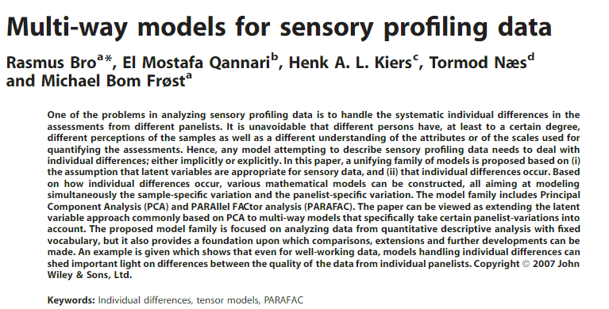
Research Paper

Slide 4
Research Questions
How can we judge the panelists consistency and descriptiveness? Does any panelist perform significantly better/worse than the others? Do the panelists agree on any variable(s)?
Can classification & regression methods be used accurately for sensory data(e.g. can we successfully classify a cream cheese class or predict the value of the sensory variables)?

Slide 5
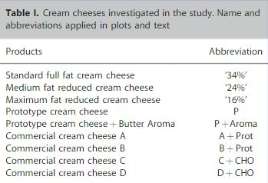
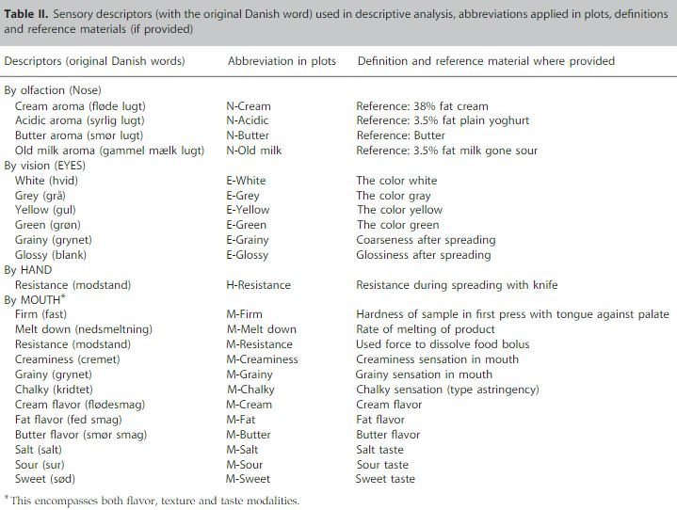
Data
1. Bro, Rasmus & Qannari, El Mostafa & Kiers, Henk & Næs, Tormod & Frøst, Michael. (2008). Multi‐way models for sensory profiling data. Journal of Chemometrics. 22. 36 - 45. 10.1002/cem.1097.

Slide 6
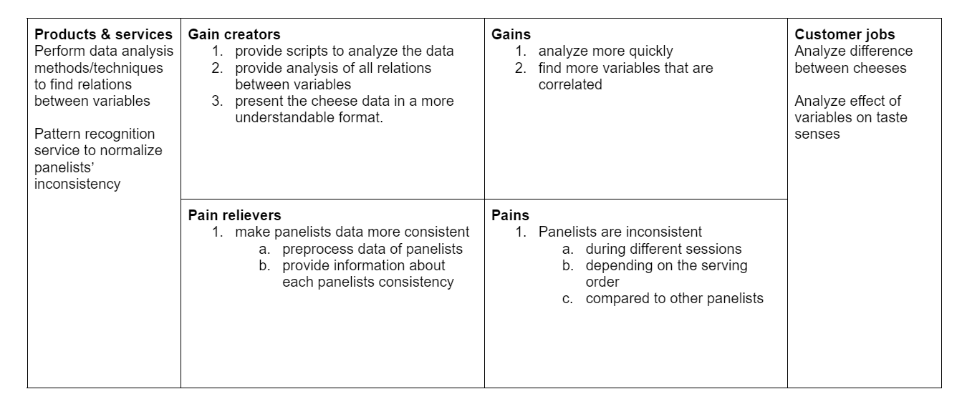
Value Proposition Canvas

Slide 7
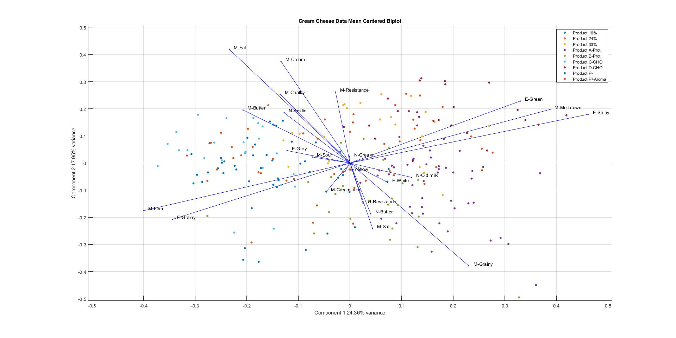
PCA – Biplot

Slide 8
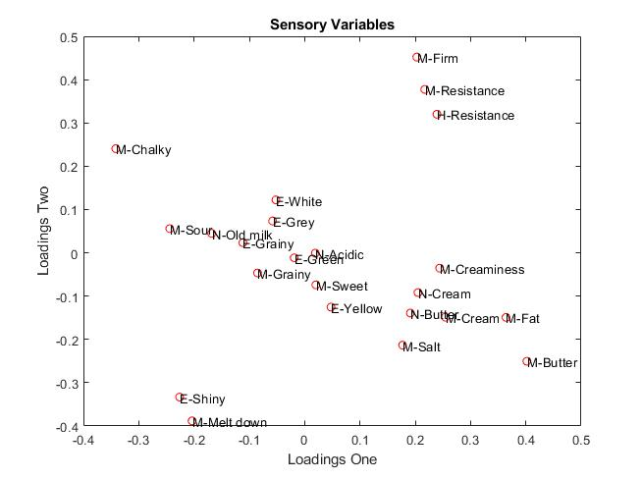
PCA- Loadings

Slide 9
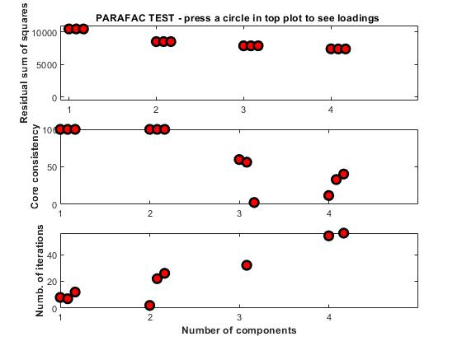
PARAFAC- Component

Slide 10
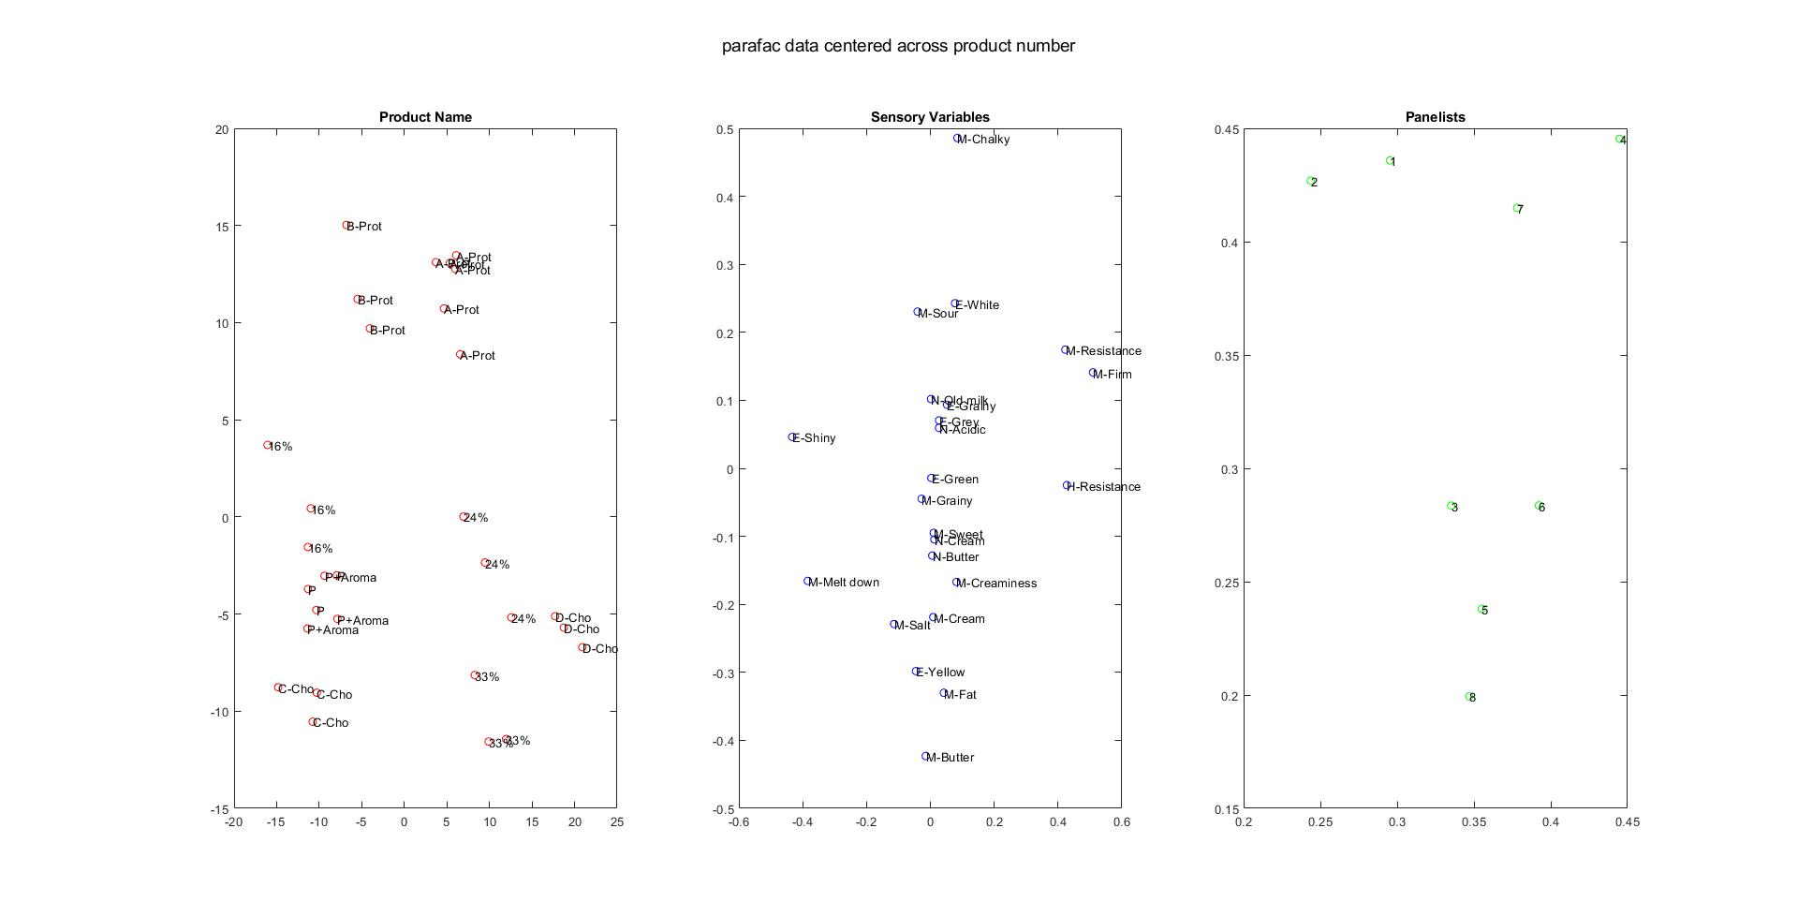
PARAFAC

Slide 11
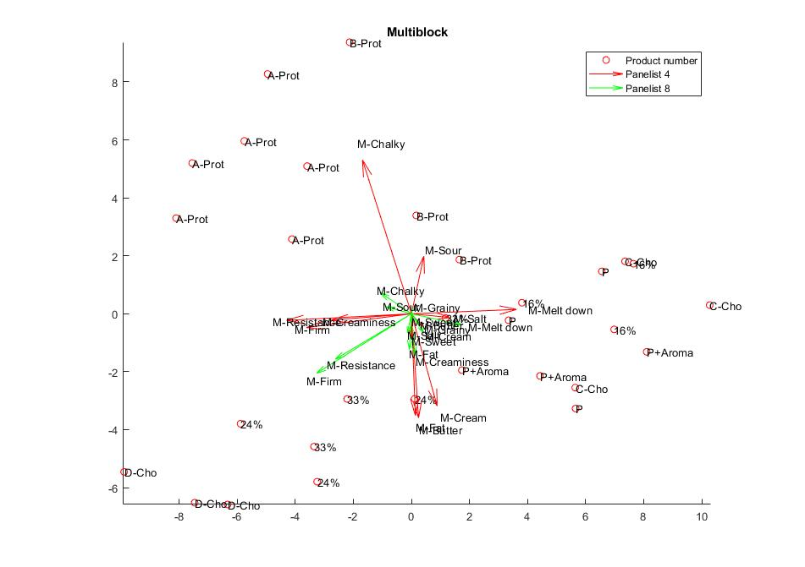
Multiblock model

Slide 12
Conclusion - PARAFAC
Panelists no.4 & no.7 perform better than the other panelists.
Panelists no. 5 & no.8 perform worse than the other panelists.
Two distinct “classes” of panelists exist.
All panelists are descriptive for texture related variables but not for the other variables.

Slide 13
Feature Selection
Multivariate methods used.
PLS-DA-Forward : selected 18 features (not only sensory variables as the Panelist variable was deemed to be important).
PLS-DA-VIP: selected 18 features with a threshold of 1.15.
PLS2-Forward: selected 10 features.

Slide 14
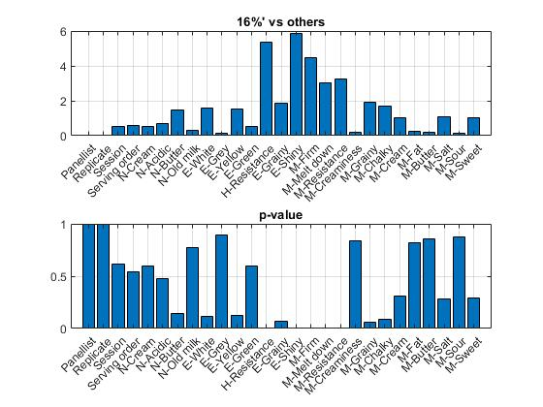
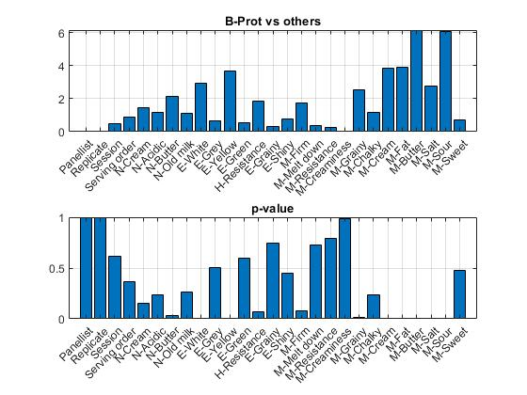
Feature Selection – Why not Univariate ?

Slide 15
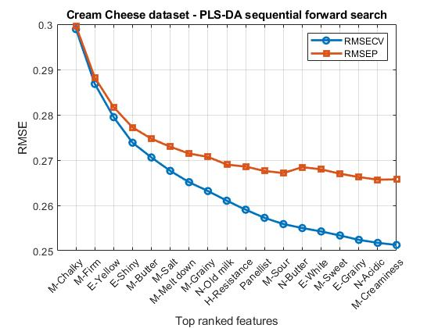
Feature Selection – PLS-Forward

Slide 16
Feature Selection – PLS-Forward
Panelist | N-Cream | N-Acidic | N-Butter | N-Old Milk | E-White | E-Grey | E-Yellow | E-Green | H-Resistance | E-Grainy | E-shiny | M-Firm | M-Melt down | M-Resistance | M-Creaminess | M-Grainy | M-Chalky | M-Cream | M-Fat | M-Butter | M-Salt | M-Sour | M-Sweet
1 | 0 | 1 | 1 | 1 | 1 | 0 | 1 | 0 | 1 | 1 | 1 | 1 | 1 | 0 | 1 | 1 | 1 | 0 | 0 | 1 | 1 | 1 | 1

Slide 17
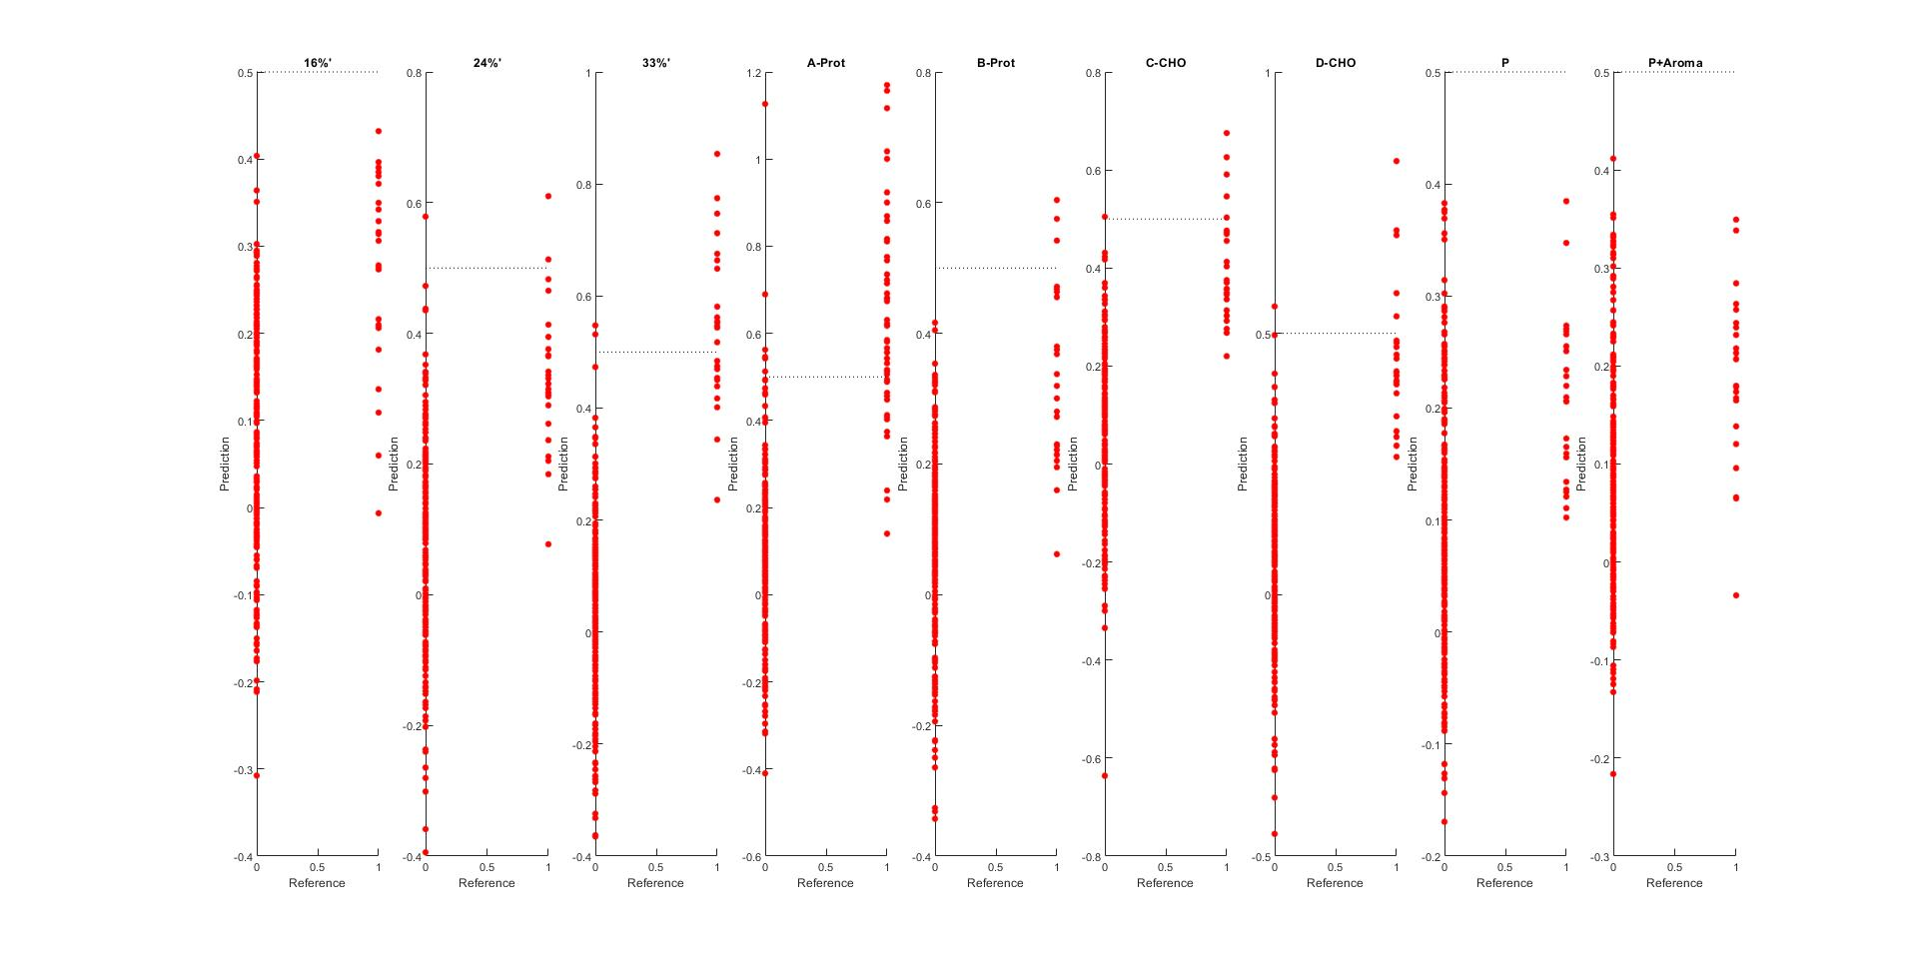
Feature Selection – PLS-Forward

Slide 18
Feature Selection – VIP
Panelist | N-Cream | N-Acidic | N-Butter | N-Old Milk | E-White | E-Grey | E-Yellow | E-Green | H-Resistance | E-Grainy | E-shiny | M-Firm | M-Melt down | M-Resistance | M-Creaminess | M-Grainy | M-Chalky | M-Cream | M-Fat | M-Butter | M-Salt | M-Sour | M-Sweet
0 | 1 | 1 | 0 | 0 | 1 | 1 | 1 | 1 | 1 | 1 | 1 | 1 | 1 | 1 | 1 | 1 | 1 | 0 | 0 | 1 | 1 | 1 | 1

Slide 19
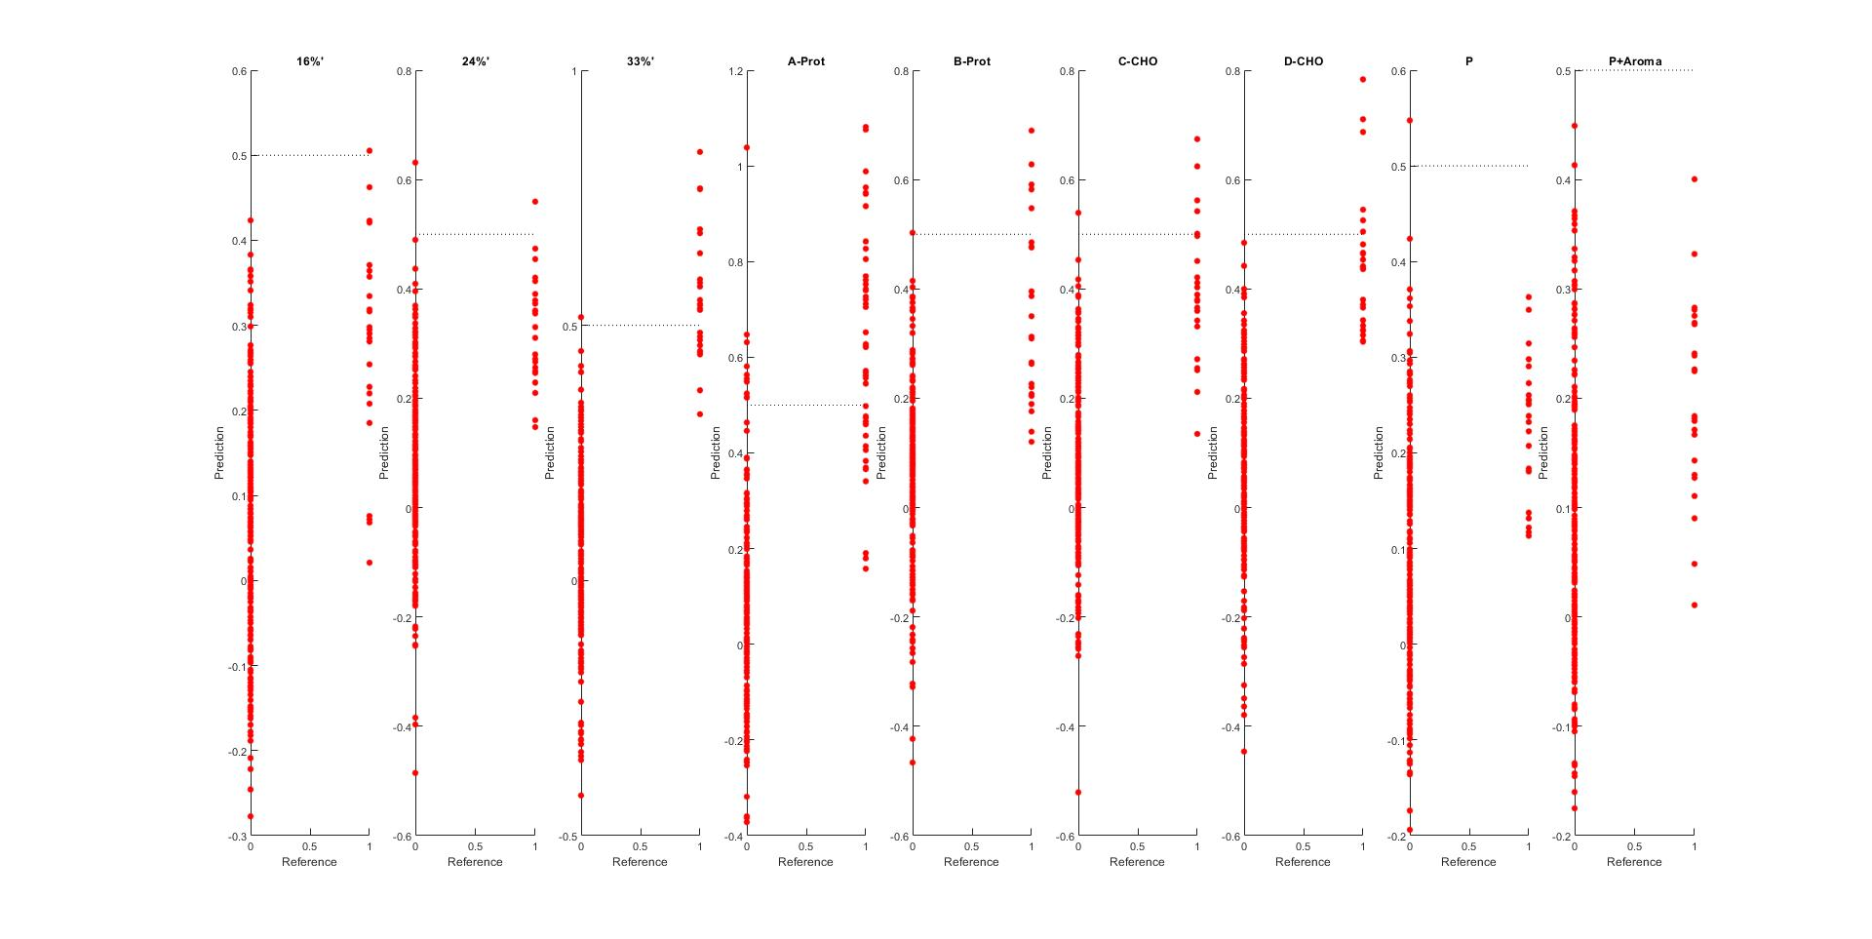
Feature Selection – PLS-VIP

Slide 20
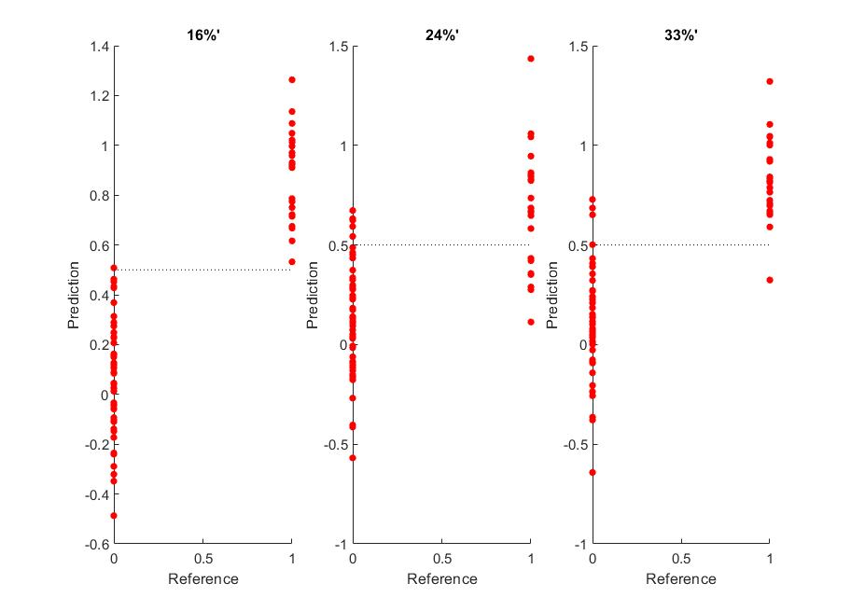
Feature Selection – With Class Reduction

Slide 21
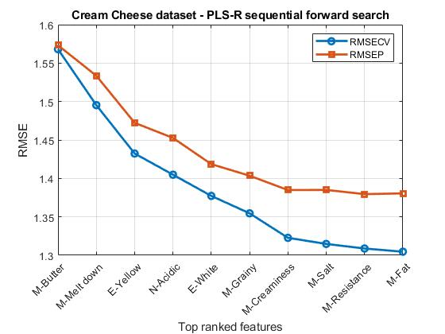
Feature Selection – PLS2-Forward

Slide 22
Feature Selection – PLS2- Forward
Panelist | N-Cream | N-Acidic | N-Butter | N-Old Milk | E-White | E-Grey | E-Yellow | E-Green | H-Resistance | E-Grainy | E-shiny | M-Firm | M-Melt down | M-Resistance | M-Creaminess | M-Grainy | M-Chalky | M-Cream | M-Fat | M-Butter | M-Salt | M-Sour | M-Sweet
0 | 0 | 1 | 0 | 0 | 1 | 0 | 1 | 0 | 0 | 0 | 0 | 0 | 1 | 1 | 1 | 1 | 0 | 0 | 1 | 1 | 1 | - | -

Slide 23
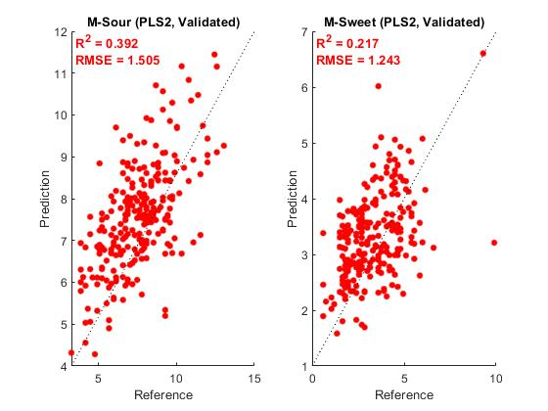
Feature Selection – PLS2-Forward

Slide 24
Feature Selection
Method | RMSECV | RMSEP
PLS-DA-Forward search | 0.25126 | 0.26575
PLS-DA-VIP | 0.25302 | 0.26682
PLS2-Forward | 1.3046 | 1.3805
PLS-DA(all variables) | 0.24799 | 0.26577
PLS2 (all variables) | 1.2614 | 1.4352

Slide 25
Conclusion – Feature Selection
Classification produces average results for sensory data and can be improved cost wise by feature selection methods.
Possibly better results would be produced if we had dug deeper into using optimization techniques & if more data was available( e.g. classifying 9 classes with 240 is rather hard).
The most important features selected were the sense associated to the mouth while vision, smell and touch related features were selected less.
Variables ‘M-Cream’ (Cream flavor) & ‘M-Fat’ (Fat Flavor)were excluded during both feature selection methods for classification.
Predicting sensory variables – even with feature selection – seems to be hard to perform but seems to improve the RMSEP.

Slide 26
Discussion
Any questions are welcome!

Slide 27

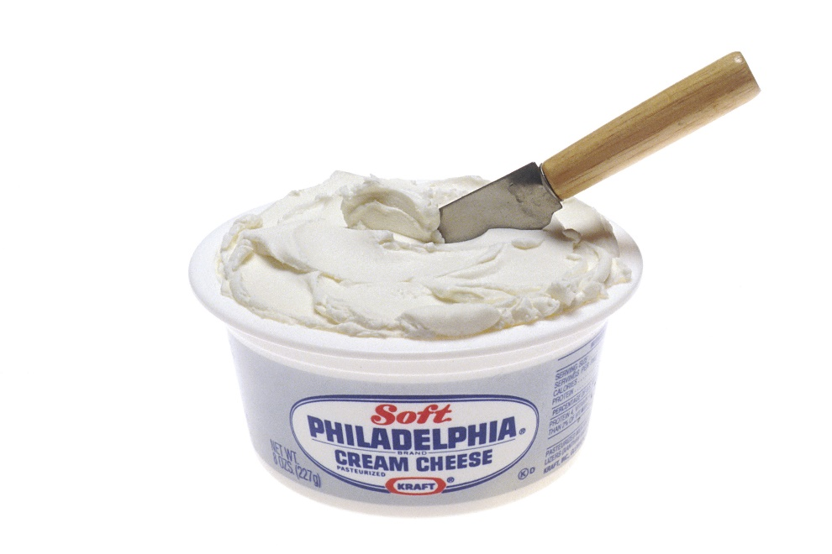
The End

